Slide 1
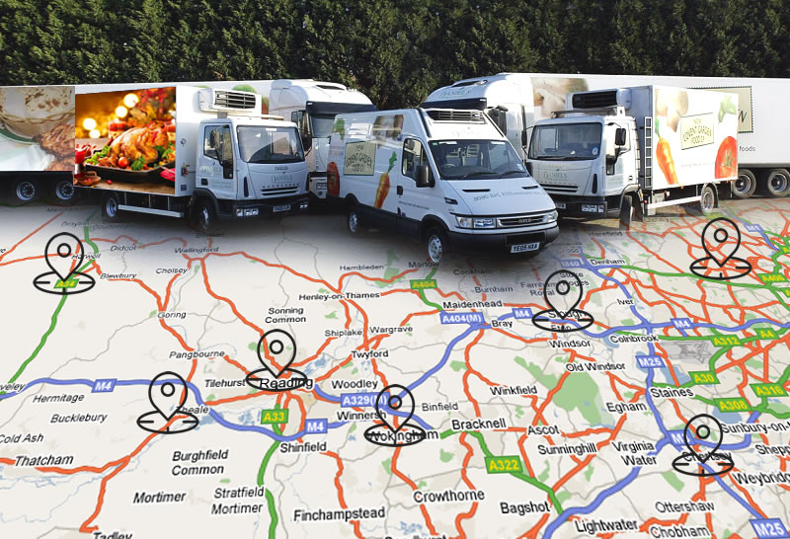

Distribution Management System
ARM Limited

Slide 2
Group Member (G-5)
Presented to
Mr. Samyan Qayyum Wahla
Presented by
Mukarram Ali (2021-CS-58)
Rayan Rasheed (2021-CS-59)
Ammad Aslam (2021-CS-67)

Slide 3
Motivation
There is always room for improvement.
Running a Distribution System without a proper application lead to many problems.
So, our Project aims to develop such an application for the Company that can address all the above problems and helps the company improve the distribution system and management of the company processes.
The Distribution Company that we have plumped for is the Shoe Distribution Company.

Slide 4
Industrial Need
Challenging business environment and rapidly changing one.
Distribution Company is not using a proper, well-managed application then it is facing commercial suicide.
Searching for a 10-year-old record for the company is extremely challenging.
The company has no way of knowing how much stock is left in your warehouses and how much you’ve sold out.

Slide 5
Description
The Distribution Company that we have plumped for is the Shoe Distribution Company.
The implementation of this application will work with a company called ARM.
As a distribution company we deliver 19 types of Shoes to numerous retailers, wholesalers, concept stores, buyers, and agents all over Lahore.
Providing Four authorized modes.

Slide 6
Modules
Field Management
Inventory Management
Employee Management
Sales Management
Payment and Finance

Slide 7
Some Features
Attendance: Daily Attendance of all Employees.
Payments: Payment in installments or in advance for the client.
Orders: All supplier orders are authorized by the Manager.
E-mail Communication: Email-sending service to make precise connections between employees, managers, supervisors, and clients.
Availability: The rider will be informed of the stock availability during placing orders.
Maps: Google Maps facility for riders.
Versatile: Print Bills and reports.

Slide 8
Actors and Stakeholders
Actors
Stakeholders
The Manager
Inventory Supervisor
Sales Agent
Rider
Government
Supplier
Clients

Slide 9
Actors Description
The Manager :
Manager can hire and fire employees to the Company.
He can view all the records or monthly reports and stock.
He also has to check the performances at all times, and check inventory.
He gives monthly incentives to all the employees according to their performance.
Inventory Supervisor :
He can buy stock from the supplier after the approval of the General Manager. He will provide authorization to the rider after checking the stock from the warehouse.
This system will also have an inventory supervisor. He will manage inventory in the warehouse and will notify the general manager whenever a new order should be made.

Slide 10
Actors Description
Sales Agent :
The sales Agent will also have an account of their own. He will keep a track of all the orders of the riders and their information.
He will assign a specific area to a specific rider. He can also update the location of riders. He will send out emails to the client after the delivery of the product.
Inventory Supervisor :
The Rider has most of the responsibilities in the system. The rider will take orders from the shopkeepers and deliver the order afterward.
The rider is able to see the products when creating an order.
He can view the history of his delivered orders and can also view pending orders (to be delivered). He will send out emails to the sale agent about the order placement.
He can add and update the client data.

Slide 11
Use Cases
Manager
Inventory Supervisor
Add Employee
Deduction of Fuel Money
Give Salaries
Give Bonuses
Update Employee
Add Vehicle
Delete Employee
Buy Stock
Update Stock
Inventory Report
Report Cost
Rider
Take Order
Add Client
Cancel Order
To-do List
Record Fuel Details
Sales Agent
Assign location
Track orders
Provide path directions to rider

Slide 12
Road Map of how the system will work

Slide 13
Hire Employee
The Manager takes interviews and hires an employee ( sales agent, inventory supervisor, and rider).
Buying Stock
The inventory Supervisor buys stock from the supplier that is added to the warehouse by the
Authorization of the manager.
1
2
Take Order
Rider go to the shopkeeper and take all his information including the order that the client wants to place.
4
3
Assigning a location
Sales Agent assigns a specific area and vehicle to the rider
5
6
7
Order Approval
Sales Agent approves the order and a notification is sent to the inventory supervisor.
Picking up the order
Rider picks up the order from the warehouse and the inventory supervisor updates the stock.
Order Delivery
The order is delivered to the shopkeeper and cash is added to company’s account.

Slide 14
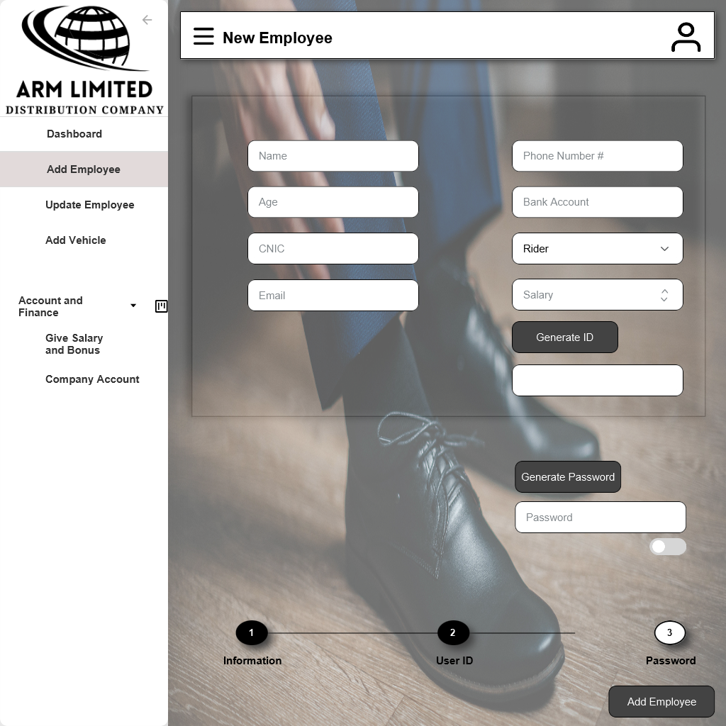
Application UI
Manager

Slide 15
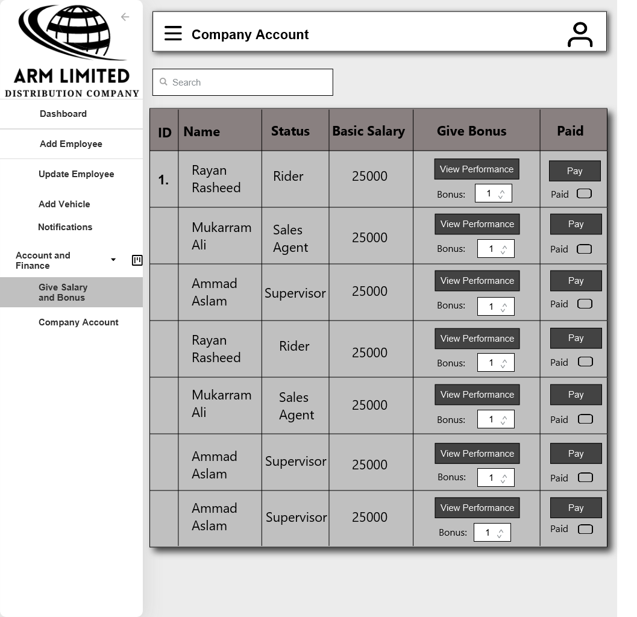
Application UI
Manager(contd…)

Slide 16
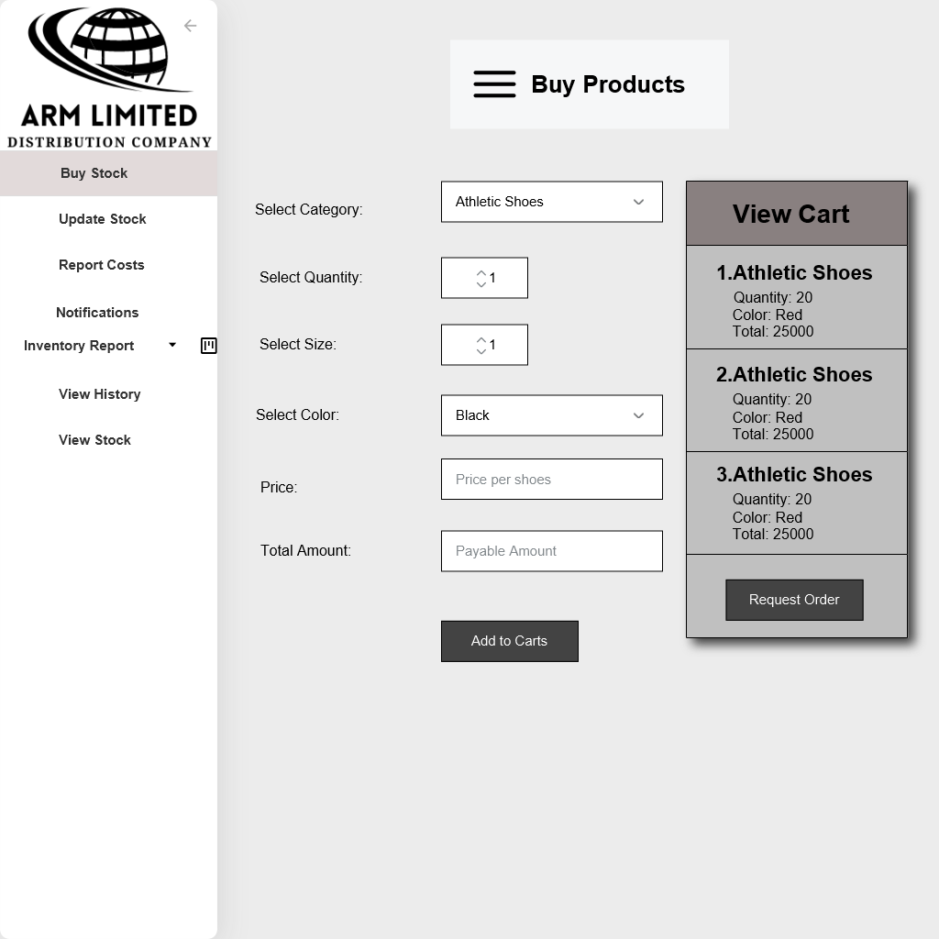
Application UI
Inventory Supervisor

Slide 17
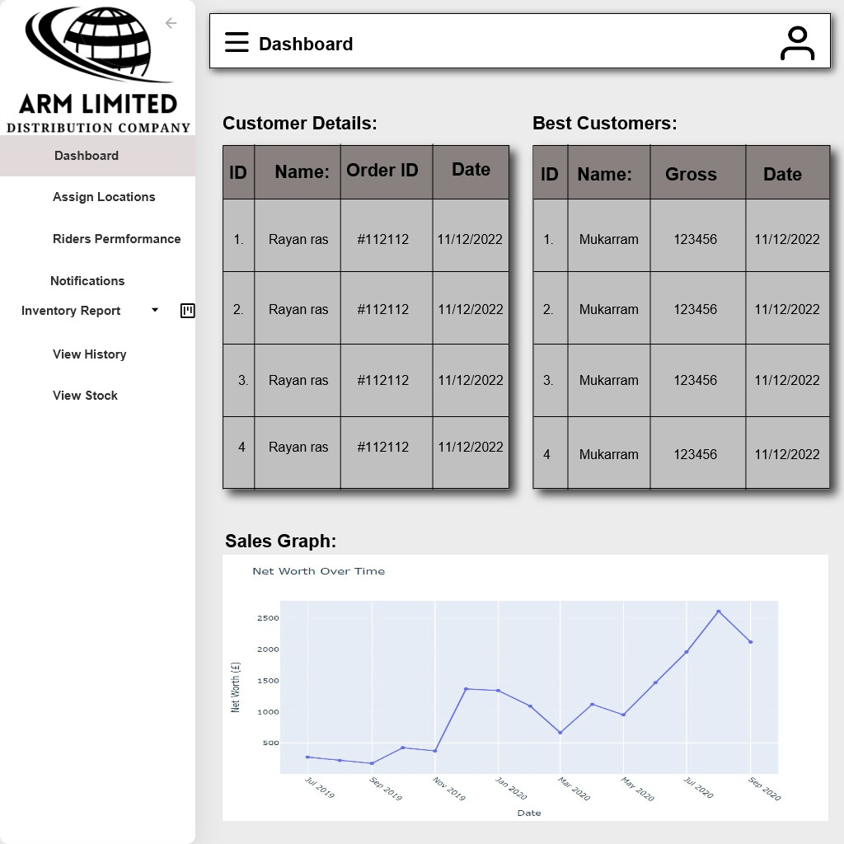
Application UI
Sales Agent

Slide 18
Data Structures
Linked List
Stack using LinkedList and Arrays
Array
Hash table
Doubly LinkedList
Queue
Binary Search tree
Graphs

Slide 19
Object Oriented Models

Slide 20
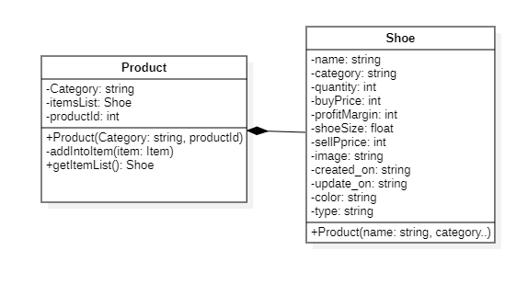
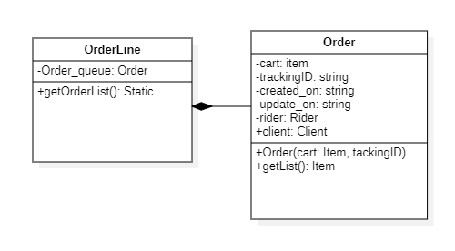
Composition

Slide 21
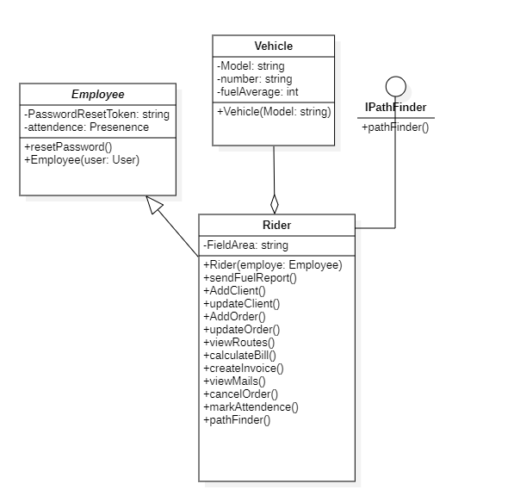
Multiple Inheritance

Slide 22
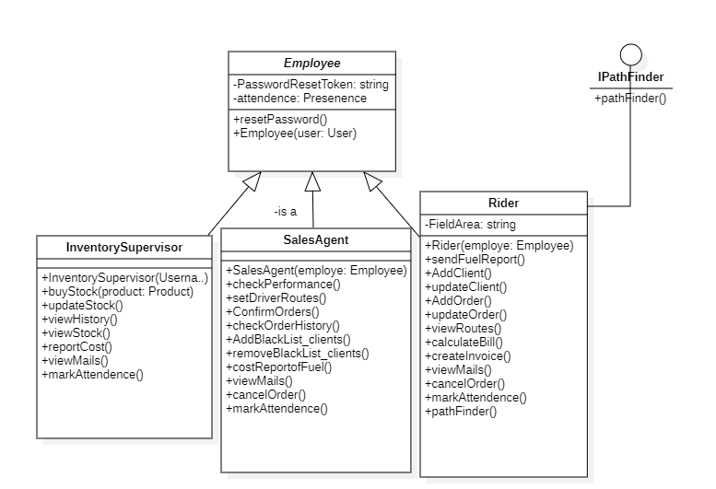
Polymorphism

Slide 23
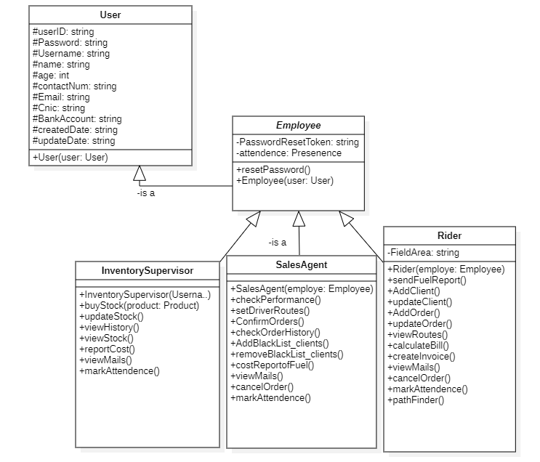
Multi-level Inheritance

Slide 24
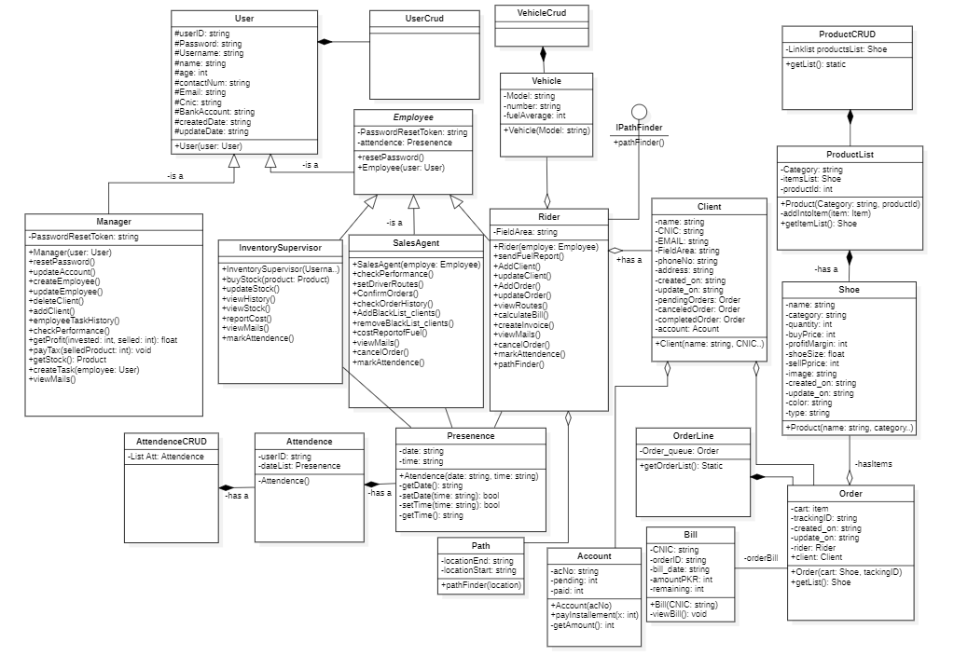
OOP Model (UML)

Slide 25
Some Email Formats
From Inventory Supervisor to Manager
From Company to any employee
Subject: Products Purchasing
Dear Manager,
Please check your notification for confirmation of order 001 from ADIDAS New York. The details are given below:
• Quantity: 1000 pieces
• Size: 8.5
• Color: Black
• Type: Flip Flops
• Price: 2000 per piece
• Total amount: 2000000
Kindly, let us know about the status of this order as soon as possible.
Thanks
Regards,
ABC
Subject: Forget Password
Dear User,
Your new password for the account is puy78992. Enter this now to have access to your account.
Regards,
ARM limited.

Slide 26
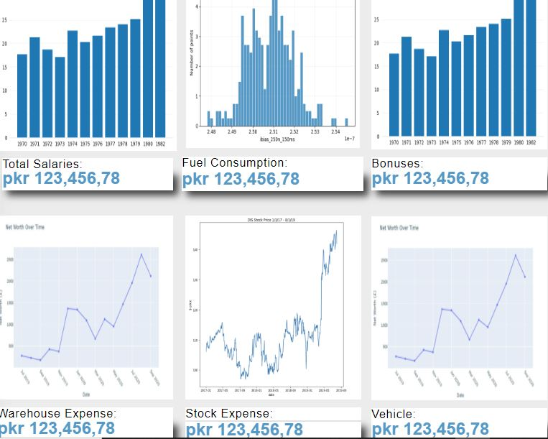
Distribution System Reporting and Analytics
Customer Relation management report
Fuel report
Sales and purchase Analytical report

Slide 27
Project Plan
Use Case Id | Use Case Name | Member Name | Estimated Completion Date
U01 | Reset Password | Rayan | 5 December
U02 | Add Employee | Ammad | 4 December
U03 | Deduct Fuel Money | Mukaram | 6 December
U04 | Give Salaries | Rayan | 9 December
U05 | Give Bonus | Ammad | 9 December
U06 | Update Employee | Rayan | 5 December
U07 | Add Vehicle | Mukaram | 4 December
U08 | Delete Employee | Rayan | 6 December
U09 | Buy Stock | Ammad | 5 December
U10 | Update Stock | Ammad | 6 December
U11 | View Inventory Report | Ammad | 8 December
U12 | Report Cost | Ammad | 9 December
U13 | Take Order | Mukaram | 6 December
U14 | Add Client | Ammad | 4 December
U15 | Cancel Order | Mukaram | 8 December
U16 | To Do list | Mukaram | 9 December
U17 | Assign Location | Mukaram | 12 December
U18 | Track Order | Rayan | 11 December
U19 | Add Fuel Details | Rayan | 13 December
U20 | Find Path | Rayan, Ammad | 16 December

